Slide 1

SECURITY ANALYSES AND PORTFOLIO MANAGEMENT
FNM694
CREDIT 3

Slide 2
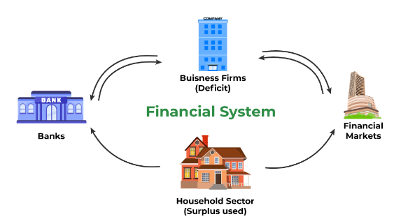
Meaning of the Financial Market
A market that serves as a link between the savers and borrowers, by transferring the capital or money from those who have a surplus amount of money to those who are in need of money or investment, is known as Financial Market.
A financial market acts as A link between surplus units and deficit units and brings the borrowers and lenders together

Slide 3
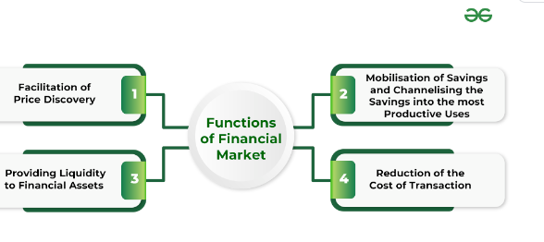
Functions of the Financial Market

Slide 4
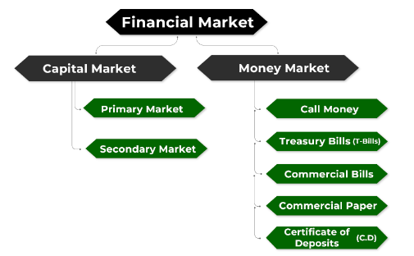
Classification of the Financial Market

Slide 5
Primary Market
New issue offer
Services for underwriting
New issue distribution

Slide 6
Primary Market
Process Of Listing New Company
3. Fixed price or Book building issue
Price Band Set by Investment Bank
Book Bidding Process
Appointment of Investment Bank
Hire a lead manager
Hire syndicate bank
Due diligence and fillings
Underwriter
Red Herring Prospectus
Compliance and fillings
Pricing
Valuation
Comparable
Discounted cash flow

Slide 7
Primary Market
IPO SETTLEMENT
QIB (50%quota)
NII (15% quota)
Retail buyers (35%)

Slide 8

TRADING PROCEDURE IN THE SECONDARY MARKET
SELECTION OF BROKER (DP)
OPENING DEMAT ACCOUNT
PLACING THE ORDER
MATCH THE SHARES AT THE BEST PRICE
EXECUTE ORDER
ISSUE OF CONTRACT NOTE
DELIVERY OF SHARES AND MAKING OF PAYMENT
SETTLEMENT CYCLE
DELIVERY OF SHARES OR MAKING OF PAYMENT
DELIVERY OF SHARES IN THE DEMAT ACCOUNT

Slide 9
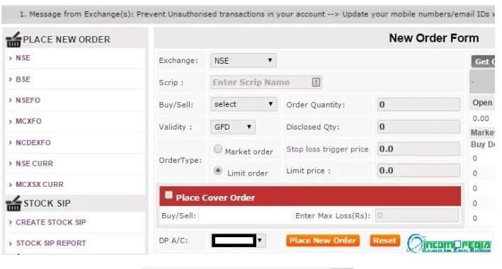

Slide 10
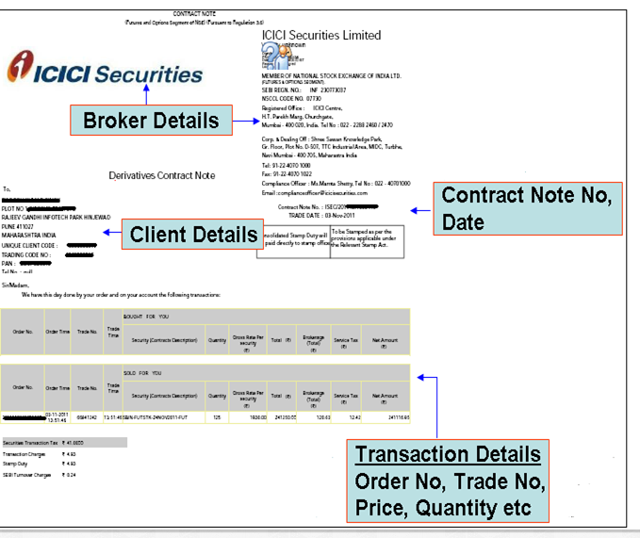
Contract Note

Slide 11
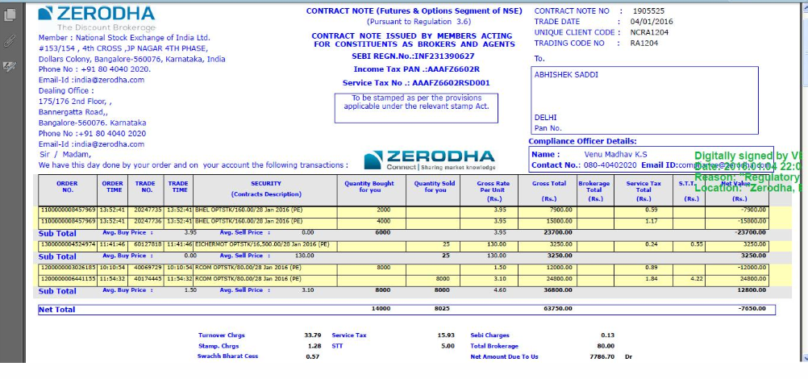

Slide 12

SETTLEMENT PROCEDURE IN THE SECONDARY MARKET

Slide 13
FINANCIAL INSTRUMENTS
Any contract that gives rise to a financial asset for one entity and a financial liability or equity for another entity.
Financial instruments can be real or virtual documents representing a legal agreement involving any kind of monetary value. Equity-based financial instruments represent ownership of an asset. Debt-based financial instruments represent a loan made by an investor to the owner of the asset.

Slide 14
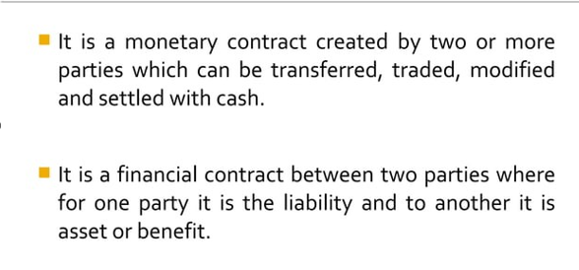
FINANCIAL INSTRUMENTS

Slide 15
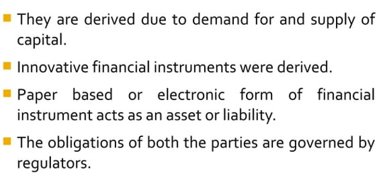
NATURE OF FINANCIAL INSTRUMENTS

Slide 16
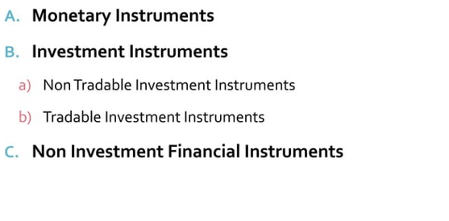
TYPES OF FINANCIAL INSTRUMENTS

Slide 17
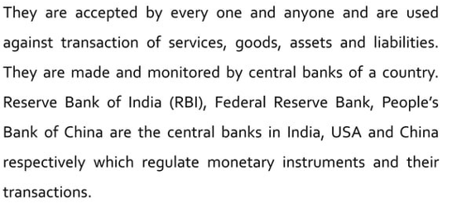
MONITORY INSTRUMENTS

Slide 18
MONITORY INSTRUMENTS
COINS
CURRENCY
CHECKS
DRAFTS
CREDIT CARD
DEBIT CARD

Slide 19
INVESTMENT INSTRUMENTS
TRADEABLE
The financial instruments which cannot be transferred and not marketable are known as non-tradeable financial instruments.
Some of them have liquidity some of them do not
NON-TRADEABLE

Slide 20
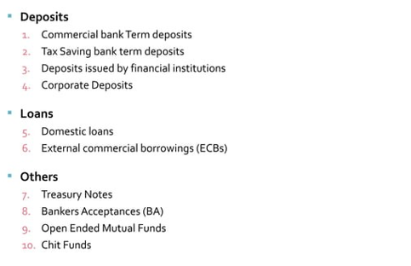
INVESTMENT INSTRUMENTS
2. NON-TRADEABLE

Slide 21
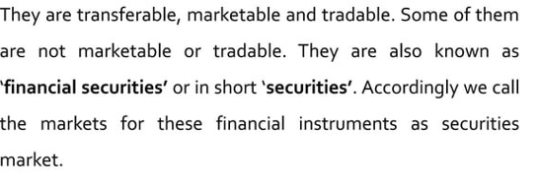
TRADEABLE INVESTMENT INSTRUMENTS

Slide 22
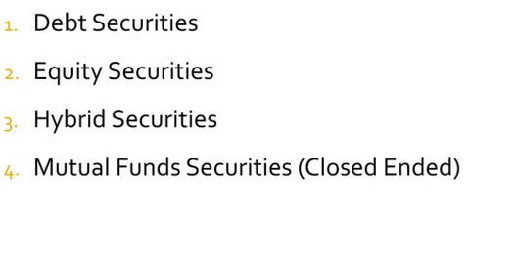
TRADEABLE INVESTMENT INSTRUMENTS

Slide 23
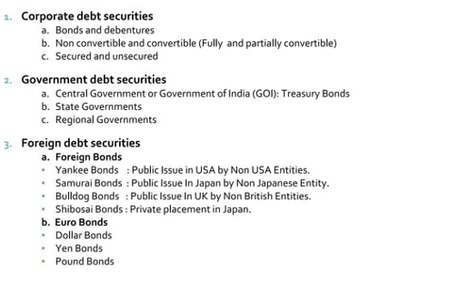
DEBT SECURITIES
1. LONG TERM

Slide 24
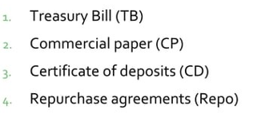
1. SHORT TERM

Slide 25
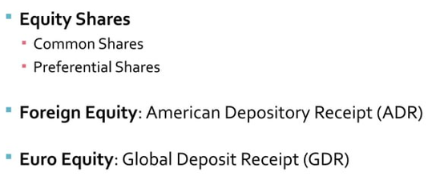
TRADEABLE INVESTMENT INSTRUMENTS
EQUITY SECURITIES

Slide 26
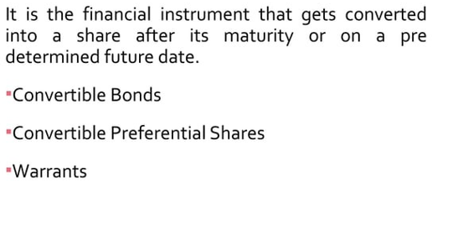
TRADEABLE INVESTMENT INSTRUMENTS
HYBRID SECURITIES

Slide 27
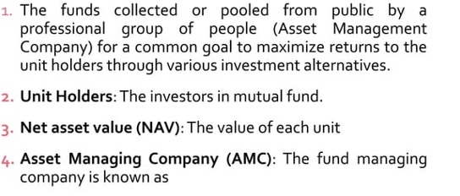
TRADEABLE INVESTMENT INSTRUMENTS
MUTUAL FUNDS

Slide 28
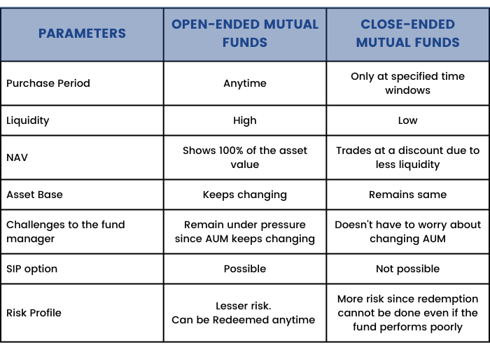

Slide 29
RISK MANAGEMENT INSTRUMENTS?
FOREIGN CURRENCY EXCHANGE?
CRYPTOCURRENCY?

Slide 30
FINANCIAL INSTRUMENTS TO ENHANCE PORTFOLIO
EQUITY STOCKS
PREFRENCE SHARES
DEBENTURES
BONDS
MUTUAL FUNDS
CERTIFICATE OF DEPOSITS
FOREIGN BONDS
EURO BONDS

Slide 31
EFFICIENT CAPITAL MARKET
Market efficiency refers to the degree to which market prices reflect all available, relevant information. If markets are efficient, then all information is already incorporated into prices, and so there is no way to "beat" the market because there are no undervalued or overvalued securities available.

Slide 32
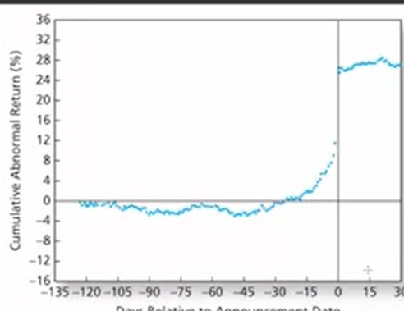
EFFICIENT CAPITAL MARKET

Slide 33
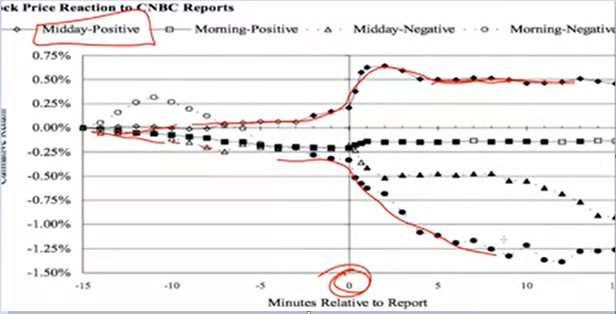
EFFICIENT CAPITAL MARKET

Slide 34
MARKET EFFICIENCY
EFFCIENT INFORMED CAPITAL MARKET
IN A PERFECTLY EFFICIENT MARKET
MARKET VALUE = INTRINSIC VALUE
IMPACT OF UNEXPECTED INFORMATION
USE A PASSIVE INVESTMENT STRATEGY
ONE MEASURE OF EFFICIENCY IS THE TIME LAG FROM INFORMATION TO CHANGE IN SECURITY PRICES

Slide 35
WHY SHOULD BE MARKET EFFICIENT
INDEPENDENTLY ANALYSE AND VALUE SECURITIES
NEW INFORMATION COMES RANDOMLY WITH UN-ANNOUNCED TIMING
THE BUY AND SELL CAUSE TO ADJUST PRICE RAPIDLY
ADJSUTMENT OF RISK

Slide 36
MARKET EFFICIENCY
FACTORS AFFECTING EFFICIENT MARKET
NO OF MARKET PARTICIPANTS
AVAILABILITY OF INFORMATION
LIMITS OF TRADING
TRANSACTION COST
INFORMATION COST

Slide 37
MARKET EFFICIENCY
OTHER RELATED TERMS
FUNDAMENTAL ANALYSES
TECHNICAL ANALYSES
ABNORMAL TRADING PROFITS
MARKET VS INVESTORS
TYPES OF INFORMATION
PUBLIC INFORMATION
MARKET DATA OR SECURITY MARKET INFORMATION
NON-PUBLIC OR PRIVATE INFORMATION

Slide 38
CAPITAL MARKET THEORY OR EFFICIENT MARKET HYPOTHESES
In 1970, in “Efficient Capital Markets: a Review of Theory and Empirical Work,” Eugene F. Fama defined a market to be “informationally efficient” if prices at each moment incorporate all available information about future values. Informational efficiency is a natural consequence of competition, relatively free entry, and low costs of information. If there is a signal, not incorporated in market prices, that future values will be high, and competitive traders will buy on that signal. In doing so, they bid the price up, until it fully reflects the information in the signal.

Slide 39
CAPITAL MARKET THEORY OR EFFICIENT MARKET HYPOTHESES
Weak Form Efficient Market Hypotheses
PRICES REFLECT ALL PAST MARKET TRADING INFORMATION SUCH AS PAST PRICES TRADING VOLUME
The weak form of the EMH assumes that the prices of securities reflect all available public market information but may not reflect new information that is not yet publicly available. It additionally assumes that past information regarding price, volume, and returns is independent of future prices.
TREND ANALYSES ARE USELESS
Semi-Strong Form Efficient Market Hypotheses
PRICES REFLECT ALL PUBLIC INFORMATION IN ADDITION TO PAST PRICES
The weak form of the EMH assumes that the prices of securities reflect all available public market information but may not reflect new information that is not yet publicly available. It additionally assumes that past information regarding price, volume, and returns is independent of future prices.
FUNDAMENTAL ANALYSES ARE USELESS

Slide 40
CAPITAL MARKET THEORY OR EFFICIENT MARKET HYPOTHESES
Strong Form Efficient Market Hypotheses
The strong form version of the efficient market hypothesis states that all information—both the information available to the public and any information not publicly known—is completely accounted for in current stock prices, and there is no type of information that can give an investor an advantage on the market.
TRADING INFORMATION + ALL PUBLIC + PRIVATE INFORMATION

Slide 41
MARKET ANOMALIES
Potential inefficiencies that cause securities to be mispriced
OVER THE YEARS, SEVERAL MARKET ANOMALIES THAT APPEAR TO VIOLATE THE EMH HAVE BEEN DOCUMENTED
Time series anomaly | Cross section anomaly | Other anomalies
January Effect: | Size effect | Closed-end fund discount
Day-off week effect | Value effect | Earning surprise
Weekend analyses | Book to market ratio | IPO
Momentum | p/e ration effect | STOCK SPLITS
Overaction | Analysts

